Slide 1
Procedural Sedation
LHSC ED Orientation
Lucy Vermeulen, 2015

Slide 2
Purpose
“to induce a state of depressed level of consciousness
but allow the patient to maintain his or her own
protective airway reflexes and oxygenation.”
Minimizes excessive movement
Minimizes pain
Minimizes anxiety
Schaffler, 2007

Slide 3
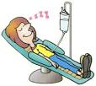
When?
Fracture reduction
Abscess incision & drainage
Chest tube insertion
Extensive debridement/suturing
Cardioversion
Painful procedures

Slide 4


How?
Opioids
Benzodiazepines
Sedative-Hypnotics

Slide 5
Preparation
Determine allergies
Determine last intake
Baseline vital signs (attach monitor),
pain score, LOC
4. Explanation of procedure with consent
5. IV access

Slide 6

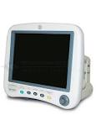
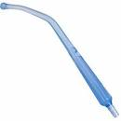
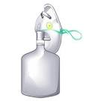

Preparation
6. Gather essential equipment:
Cardiac monitor (BP, SpO2, end-tidal)
Suction
Oxygen 100%NRB (BVM at bedside)
Endotracheal equipment
Reversal agents

Slide 7
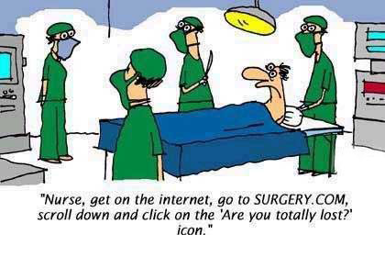
Who?
RN (1:1)
ED consultant
Patient

Slide 8
RN Role During Procedure
Monitor :
Airway/ breathing
VS, oxygen saturation
Level Of Consciousness
IV access
Document:
VS, Level Of Consciousness
Meds given

Slide 9
Procedural Drugs: Sedatives
Propofol
Fentanyl
Midazolam
Ketamine

Slide 10
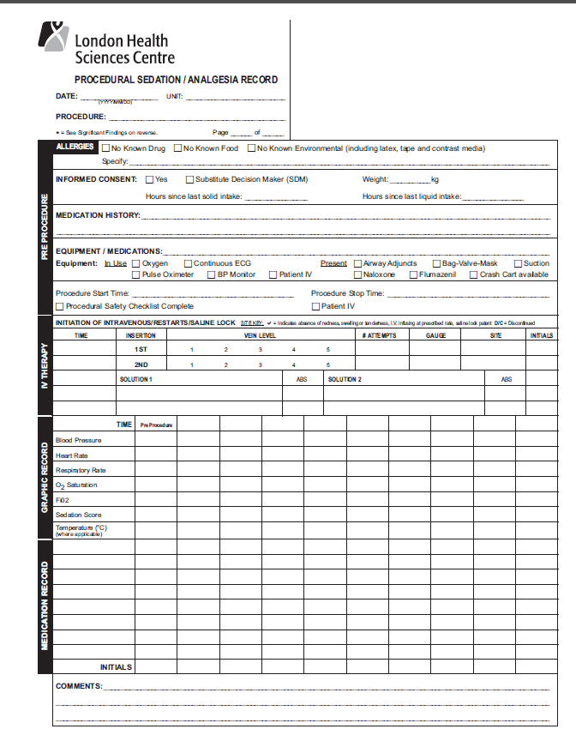
Essential
equipment
Vital signs
Q5 min
During med admin.
IV info
Record meds
here

Slide 11
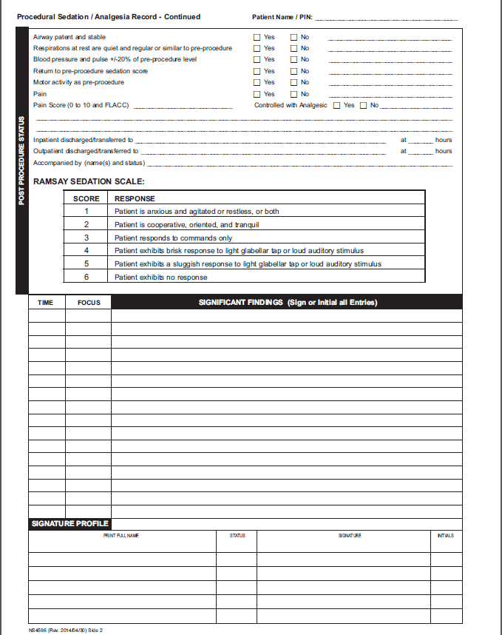
Ensure back
is completed,
including
discharge info

Slide 12
Reversal agents (have at bedside)
Narcan
used to reverse effects of opioid analgesics
ADULT: 0.1 - 0.2 mg IV, titrate as needed
PAEDS: 0.01mg/kg/dose (max 0.2mg)
onset 2 -3 mins
duration 30 - 60 mins
may eliminate narcotics analgesic effect
may precipitate withdrawal symptoms

Slide 13
Reversal agents
Flumazenil
used to reverse effects of BZD’s
ADULTS: 0.2mg over 15 sec, may repeat q60s to max 1mg
PAEDS: 0.01 mg/kg/dose (max 0.2mg) over 1 min, may repeat 0.01mg/kg every 1 min to max of 0.05mg/ kg or 1 mg
onset 1 - 3 min
duration 30 - 60 min

Slide 14
Flumazenil
Re-sedation may repeat dosing q 20 min intervals with max 1mg/dose or 3mg/hr
Re-sedation more frequently with long term BZD’s, usually within 1 hour
may precipitate seizures or cardiac arrhythmias in BZD dependent pt
Blocks benzo receptor sites: consider
pts with seizure disorders

Slide 15
REMEMBER
Keep in mind that patients
respond differently to medication.
Encourage visitors to wait in waiting room
during this procedure.

Slide 16
Post procedure
The patient must be observed until they are awake and alert, VS and LOC must have returned to pre-procedure levels
“back to baseline”
“re-sedation”
if reversal agents are used they must be observed for a minimum of 2 hours to ensure re-sedation does not occur

Slide 17
Post Procedure Treatment
X-ray
Immobilization
Health teaching
Follow-up

Slide 18
Discharge Instructions
Warn patients about subtle lingering effects of these medications, especially if using other pain medications
NO ETOH for 24 hours
No driving, heavy equipment operation
for 24 hours.
Pt. must be accompanied home by adult
new discharge sheet

Slide 19
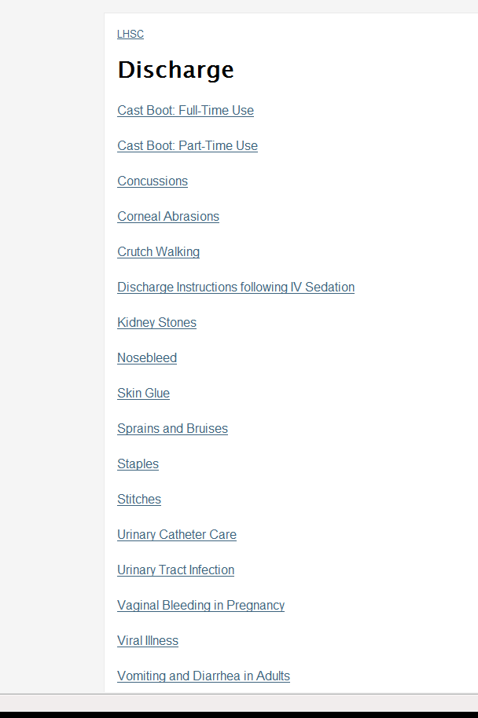
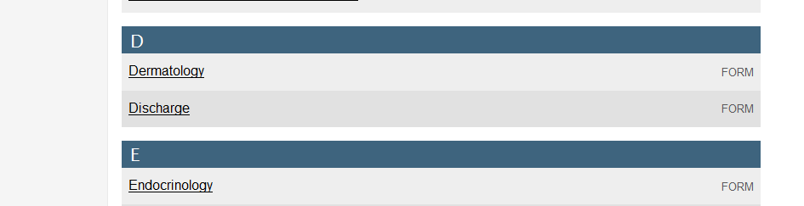
Discharge Instruction Sheet
Go to FRED on FirstNet
Click on to Discharge
Click on ‘Discharge Instructions
Following IV Sedation’
Print copy

Slide 20
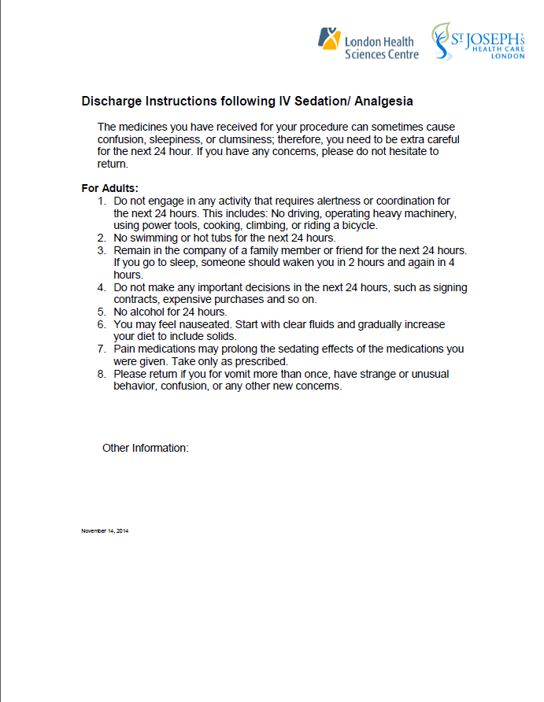

Slide 21
Documentation
How discharged?
Condition upon discharge
Who accompanied pt. upon discharge
Specifics of health teaching (no ETOH, etc.)
Did pt. understand discharge info?
Ensuring completion of this discharge info
protects the nurse from liability.

Slide 22
Case Study
17 year old presents with dislocated shoulder, previous history of same
Pain 8\10, obvious deformity
Seen immediately and MD wants to reduce the dislocation---you’re assigned to assist
What do you do assist with this?

Slide 23
Reference
Schaffler, R.L. (2007). Emergency Nursing Core Curriculum, 6th ed. K. Hoyt & J.
Selfridge-Thomas (Ed.). St Louis, Missouri: Saunders Elsevier.

